Slide 1
Blind Creek Beach August 13, 2019

Slide 2
Basic Facts
408 Acres
44 acres - Beach Dune
36 acres - Coastal Strand
2 acres - Marine Hammock
322 acres - Tidal Swamp
4 acres - Other

Slide 3
Basic Facts Continued
Leased from the:
Board of Trustees of the Internal Improvement Trust Fund
South Florida Water Management District
Leased to the Mosquito Control Division of SLC

Slide 4
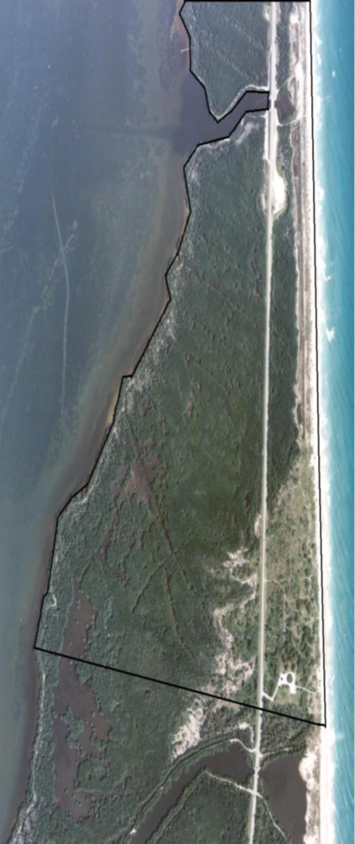
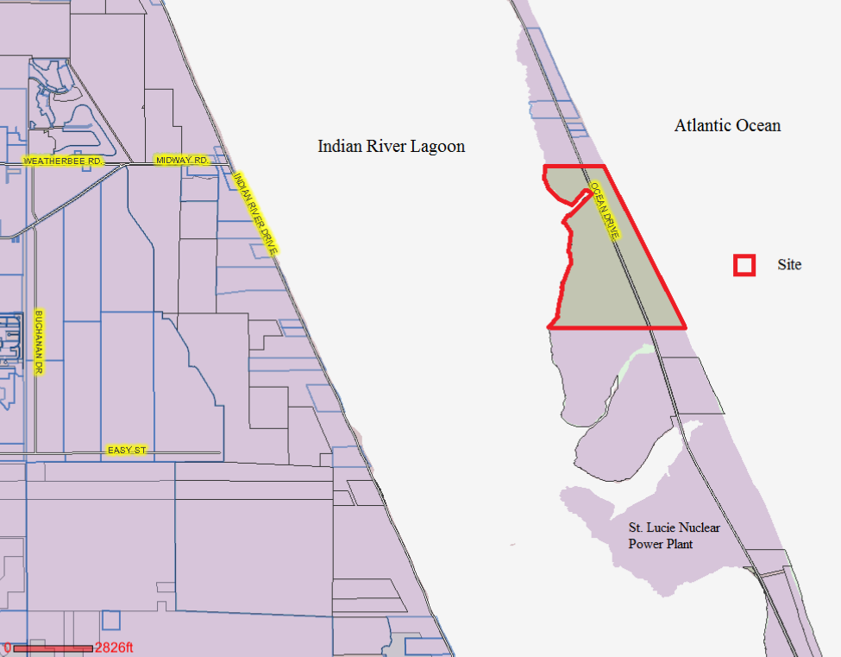
Notes:
Current Allocation 5Cent 6Cent
Port St. Lucie 66.13% 66.13%
Fort Pierce 15.29% 15.29%
St. Lucie Cty. 18.51% 18.51%
St. Lucie Vill. .07% .07%

Slide 5
Amenities
Hiking
Fishing
Canoeing
Single lane boat launch
3 parking areas
Observation tower
4 fishing/crabbing docks

Slide 6
The Operation & Management Plan guides our use of the property.
This incudes:
Protecting and/or restoring land to its natural state & condition
Conserving and protecting water resources
Providing public use
In addition:
Fencing
Entrance sign
Access to roads & trails
Public accommodations

Slide 7
The Naturist Usage
Have been using the site for 20+ years
Organized in 2014
Well Organized Website
Began formal effort to have beach formally recognized as clothing optional in 2014

Slide 8
Moving Towards the Goal
On July 9, 2014 the Tourist Development Council voted unanimously to support the organization of a clothing optional beach in SLC.
On July 15, 2014 a memo from Charlotte Bireley, Tourism Manager, to Dan McIntyre, County Attorney, identified two areas, John Brooks & Blind Creek, as potential sites.
Thereafter little success was made to accomplish goal.

Slide 9
Road Blocks
In October 2015, the State DEP, Bureau of Public Land Administration, stated that clothing optional is not authorized on state lands.
They also identified Section 877.03 F.S. as prohibiting nudity on public beaches (breach of peace: disorderly conduct)
The issue was dropped and no formal action was taken.
The Naturists took the “no action” as the County being benignly supportive and marched forward.

Slide 10
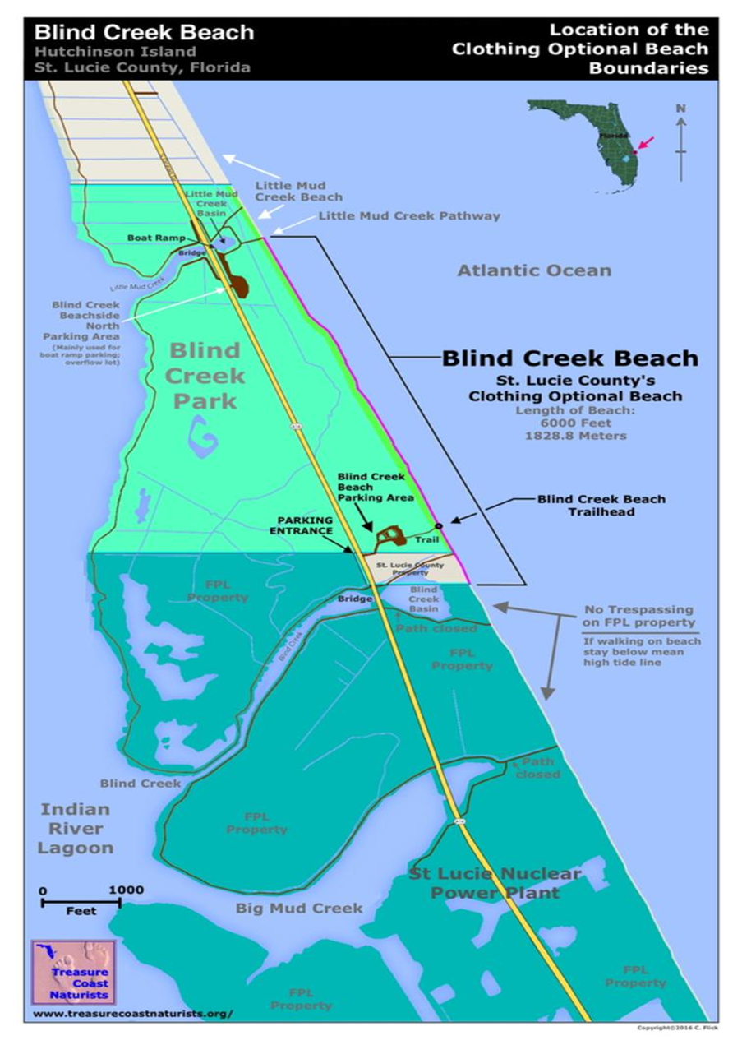
In mid 2018, I was assigned by Mr. Tipton to review the situation with an eye on formally designating Blind Creek as clothing optional.
Looking at the site and the naturist web page it was apparent that they expanded their area to the entire length, 5500± ft. of oceanfront beach.

Slide 11
Given the information above, the question of officially recognizing BCOB for what it is principally used for, a clothing-optional beach in St. Lucie County, would seem to be clear. It is not clear, however, due to a number of interfering elements. Several maps are attached for your review as you read the following interfering elements. They are:
The County only owns 468 +/- feet of ocean front property which is approximately 500 +/- feet south of the dune crossover.
The County leases nearly 5,500 feet of ocean front property north of the county’s property, from the South Florida Water Management District and the Board of Trustees of the Internal Improvement Trust Fund of the State of Florida. They have told us as far back as October 20, 2015 that a “clothing optional beach” has not been authorized by the Board of Trustees of the Internal Improvement Trust Fund of the State of Florida owned property.
The property to the immediate south of the County’s property is owned by Florida Power and Light.
And while we know the concentration of beach goers use the beach directly to the north and south of the crossover a review of the attached map shows the northern edge of the County’s property is approximately 400 +/- feet south of the crossover.
The main parking areas are on property leased from the State with only the entrance on County property.
Unsuspecting textiles have submitted occasional complaints when they were surprised by nudity on the beach with no warning.
Previous discussions with both the State of Florida and FPL have resulted in a continued lack of support for clothing optional activities on their properties.

Slide 12
My initial review found that BCOB is being rather heavily promoted as one of the State of Florida’s clothing optional locations.
A Google search turned up the following promotions for BCOB:
Visit Florida – the official Florida tourism industry marketing corporation.
Le Courrier, a French publication
Granite Media Groups Publication - Far & Wide
Fort-pierce.net
Trip Advisor
VeroNews.com
TC Palm
YouTube Video
Allevents.in – Fort Pierce
Indian River Magazine

Slide 13
In order to verify and understand the utilization of this beach in relation to other oceanfront beaches in St. Lucie County, a traffic study was conducted at the following beaches:
Blind Creek
Waveland
Dollman
Frederick Douglas
John Brooks
The counts were taken by our traffic division in the last two weeks of August, 2018. It should be noted that these counts were taken during a non-snow-bird month. This last snow-bird season the parking area was full on a regular basis based on casual observation.

Slide 14
The results are shown in the following table:
 |  | # OF | AVERAGE
BEACH | COUNT | DAYS | PER DAY
Blind Creek | 3,621.00 | 10 | 362.10
Waveland | 1,458.00 | 10 | 145.80
Dollman | 935.00 | 10 | 93.50
F. Douglas | 584.00 | 10 | 58.40
J. Brooks | 521.00 | 10 | 52.10
As you can see from the table above, BCOB is by far the most heavily used beach of the five (5) beaches listed by a minimum of 248% above the next highest used beach - Waveland

Slide 15
My Journey
Seeking approval of a clothing optional beach on state lands from the State Division of Lands was met with the same resistance as in 2015. Not authorized; a clothing optional beach may preclude or defer portions of the general public from using the beach in question, and; The State does not see how this advances the “public purpose” under their guidelines.
I proposed that the State formally turn over the land to the County since we have maintained it. Their response: “The BOT would not be able to outright sell the land to the County. There is a process in place to surplus land. The County would first have to request a release of the lease. The parcel would then be noticed to all State Agencies, State Colleges and State Universities for an opportunity to enter into a new lease for the parcel. Should the parcel not be leased, the parcel would be surplused and sold by a competitive bid. State Lands can’t guarantee that the County would win the bid.

Slide 16
The First Movement
In a phone call with State Lands in February, 2019, State Lands indicated that while they cannot sell the property to the County they have entertained a swap of lands. So:
A letter dated February 28, 2019 to Division of State Lands Director offered a swap of Frederick Douglas, which has 1,033 feet of ocean frontage with an equivalent frontage on Blind Creek. We would then lease back Frederick Douglas.
Their response:
We typically require a two for one swap. And they still struggle with the public purpose of the effort.
A frustrating process became more complicated and more difficult to comply with or justify.

Slide 17
And then the major change in the position of State Lands.
During the 2019 Legislative session our Legislative coordinator met with State Lands and a lobbyist for the naturists.
As a result we were told that according to their new attorneys we can accomplish this through a County Ordinance.
Then we were told as recently as two weeks ago that we might be able to accomplish our goal with a resolution.
Our path:
We are proceeding with a simple Ordinance amendment.
Mosquito Control proceeding with update to Management Plan to include clothing optional as permitted public use.
A Resolution will be prepared to provide clarity to the use of Blind Creek Beach as clothing optional and expectations of the Naturists.

Slide 18
Questions?

